Slide 1
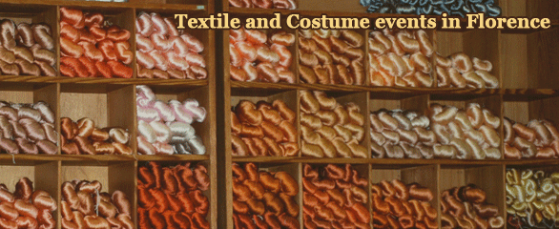
Costume Colloquium II: Dress for Dance
www.costume-textiles.com
November 4th – 7th 2010
Florence, Italy

Slide 2
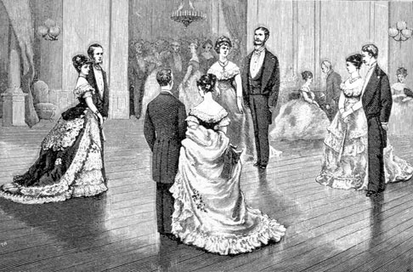
Following the great success of Costume Colloquium: A tribute to Janet Arnold (held in Florence in 2008, attended by over 315 participants from 26 countries, with 39 presentations on 8 themes) a second symposium will take place in November of this year dedicated to the fascinating subject of Dress for Dance

Slide 3
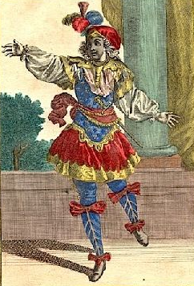
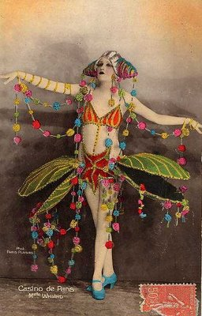
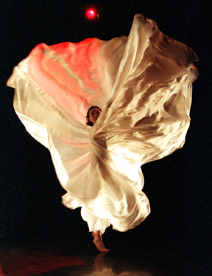
Costume Colloquium II will explore interdisciplinary aspects of dance dress and costume, this multi-cultural mode of human expression, from a variety of practical, historical and creative perspectives.

Slide 4
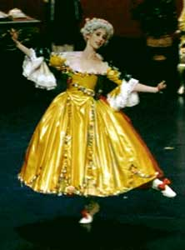
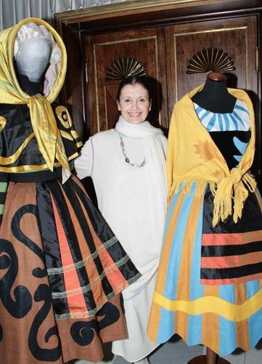
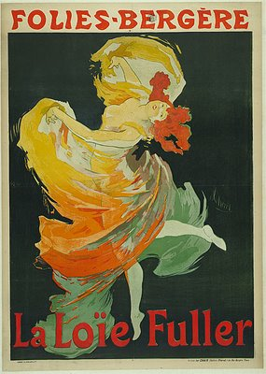
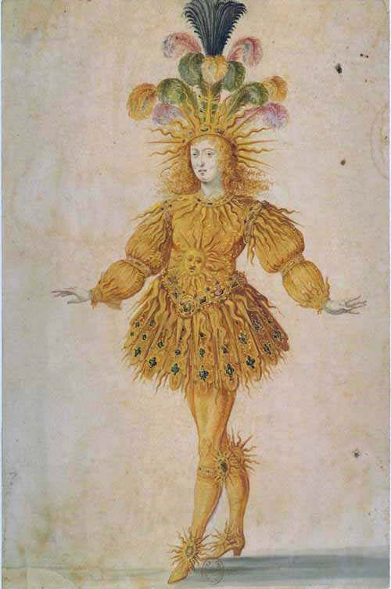
A wide variety of papers and presentations will provide
participants with new and in-depth knowledge regarding unpublished research, new creations and/or practical
experiments related to all of the multi-faceted themes of
Costume Colloquium II: Dress for Dance.

Slide 5
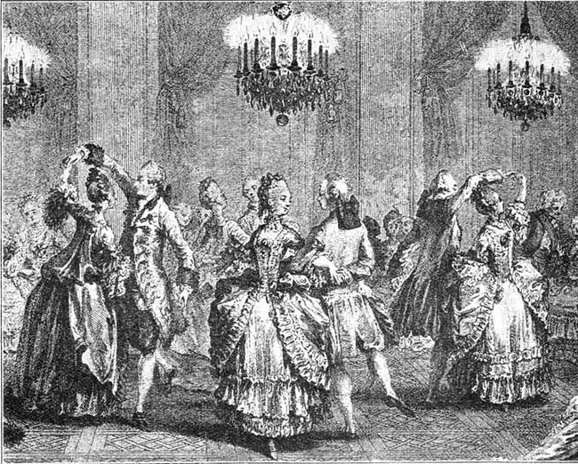
Parallel to the academic sessions there will be several special events and venues which will give the participants an opportunity not only to visit never before seen treasures, but also to network and socialize with one another.

Slide 6
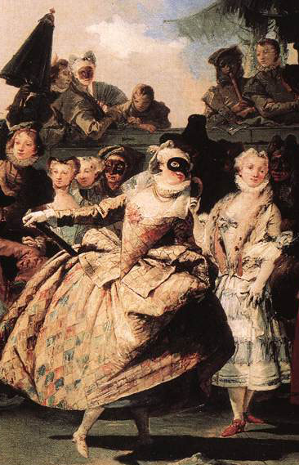
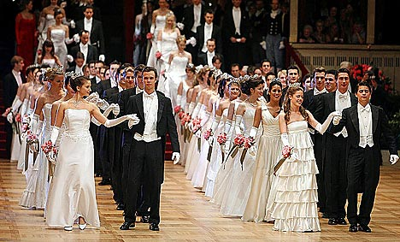
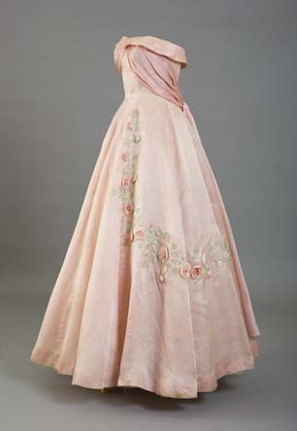
A unique symposium for:
costume and dance historians
costume designers
costume makers
museum curators
archivists and researchers
textile and costume conservators
dancers and dance re-enactors
choreographers
students
members of the public
Learn from Experts in the Field

Slide 7
The Advisory Committee has selected 33 papers submitted by experts from around the world representing 16 nationalities.
Australia
Canada
Croatia
Czech Republic
England
France
India
Ireland
Italy
Lebanon
New Zealand
Mexico
Poland
Russia
Serbia
United States of America

Slide 8
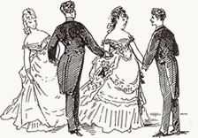
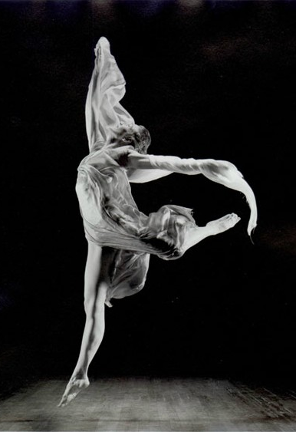
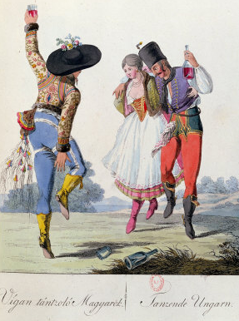
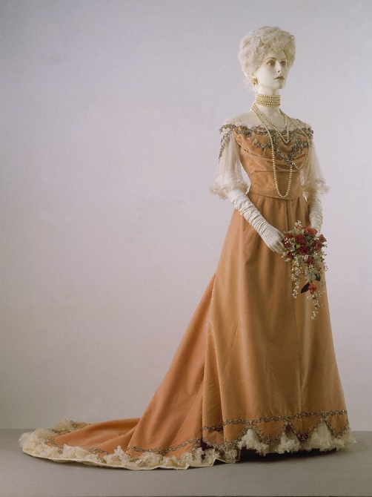
The papers and presentations
cover topics which will incorporate both
theoretical and practical perspectives
of the 8 Academic Sessions which are:

Slide 9
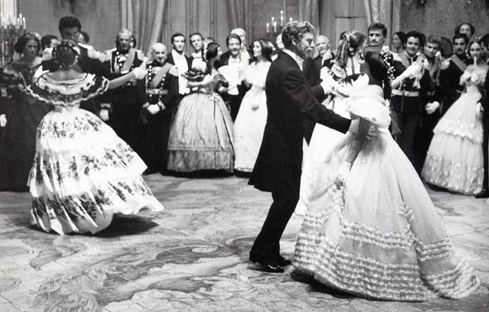
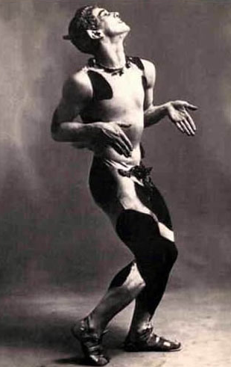
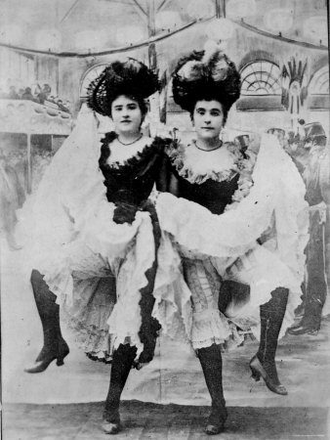
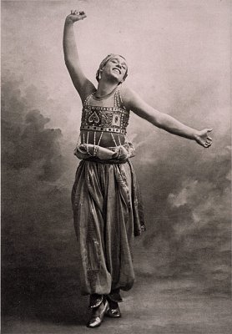
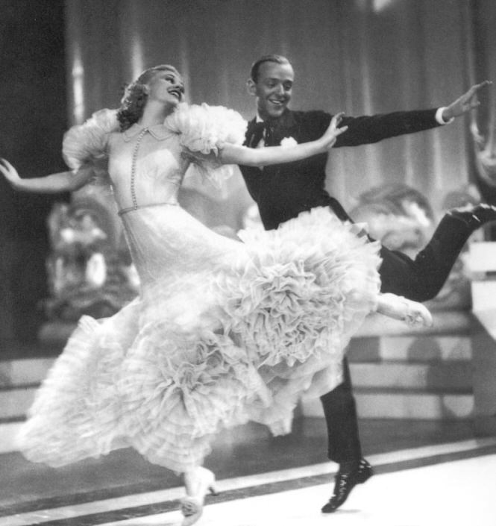
I. History of dance costume for professional performance: theatre, ballet, cinema, etc.

Slide 10
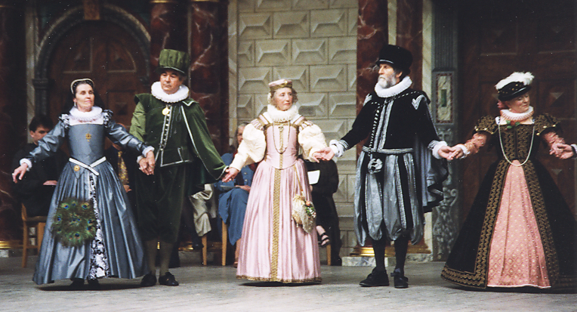
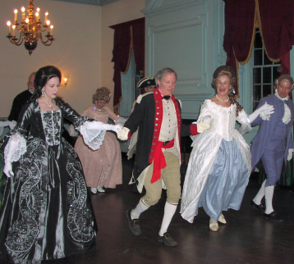
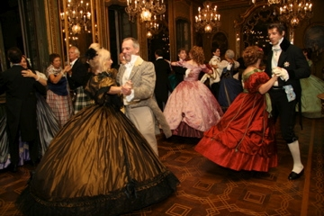
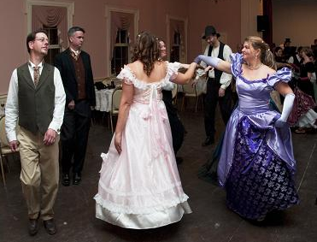
II. Historical dance re-enactment: getting the steps and the clothing right

Slide 11
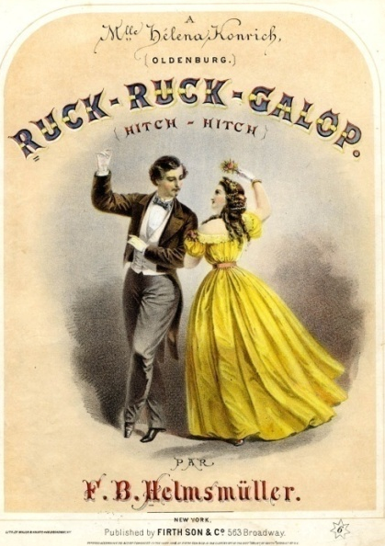
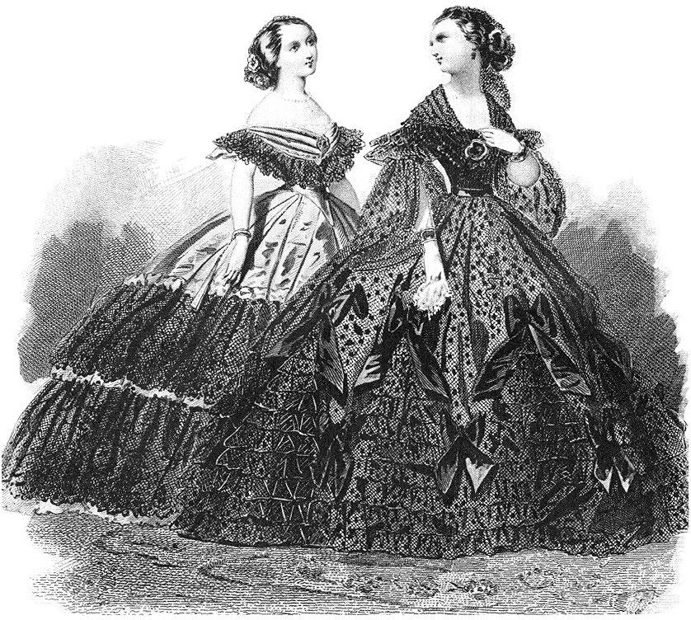
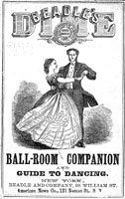
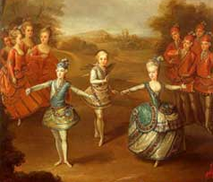
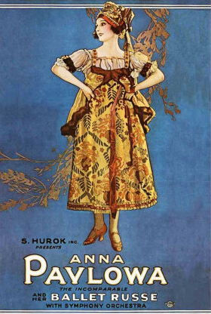
III. Documenting dance dress: dress as a document and documents of dress

Slide 12
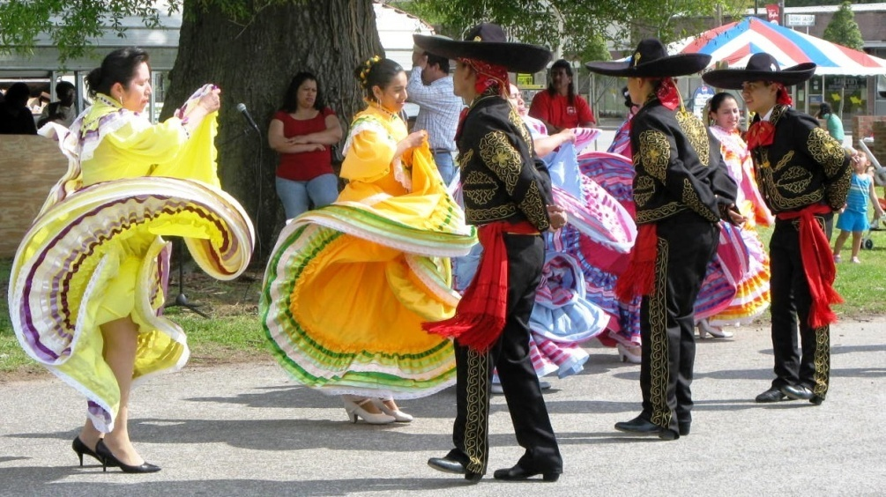
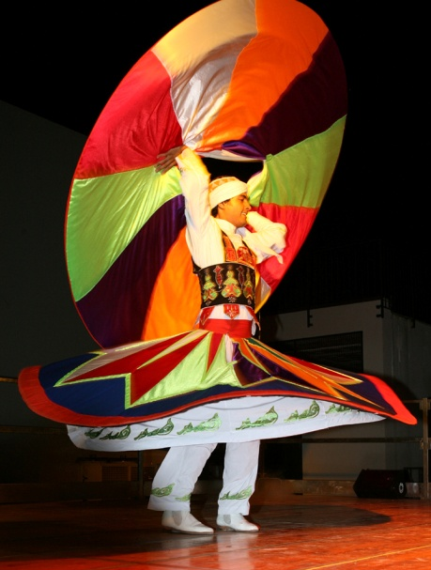
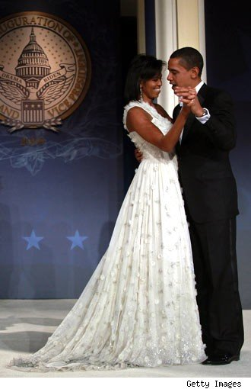
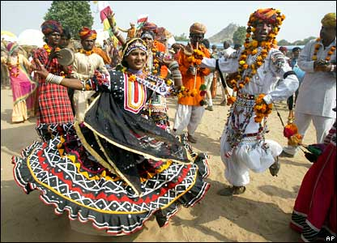
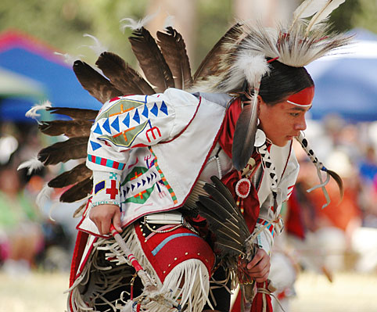
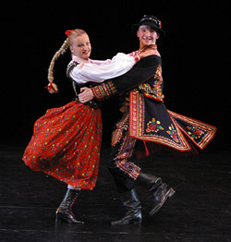
IV. Dress for traditional and ceremonial dance: costume as expressions of cultures

Slide 13
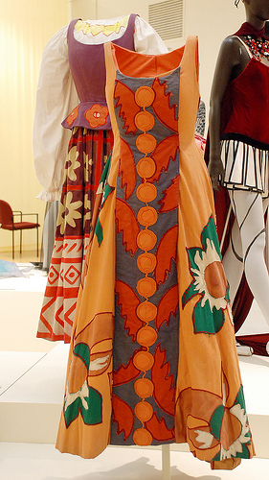
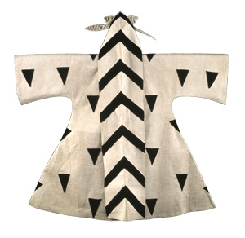
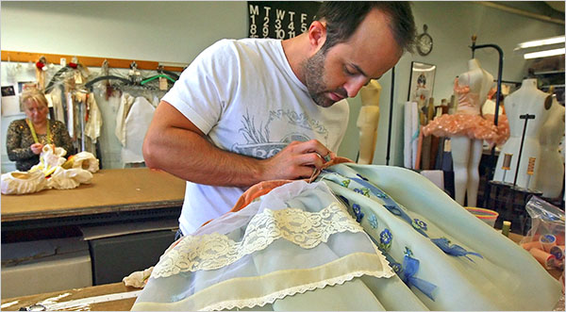
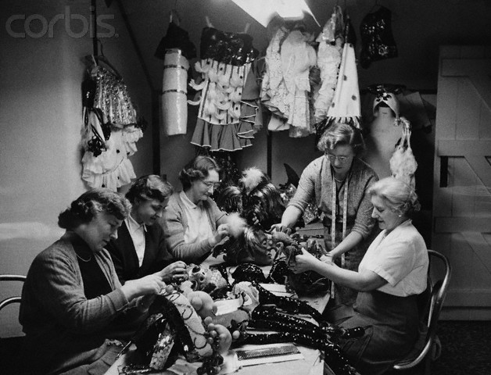
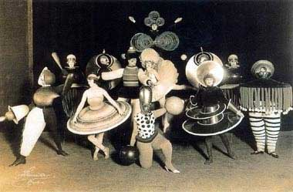
V. Creating dance costume: designers, artists, artisans, stylists, tailors, seamstresses using traditional, experimental and/or contemporary materials and techniques

Slide 14
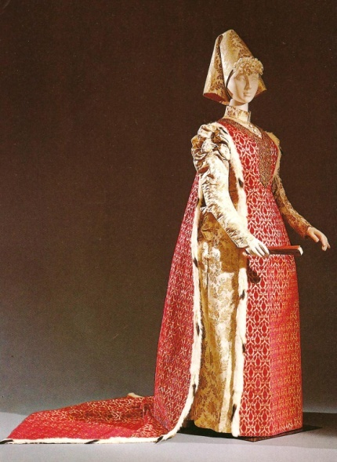
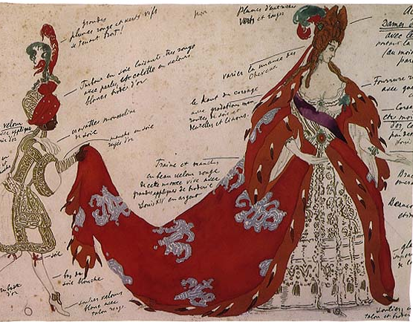
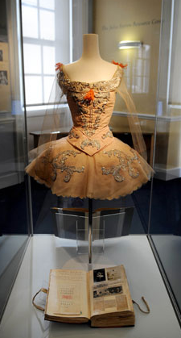
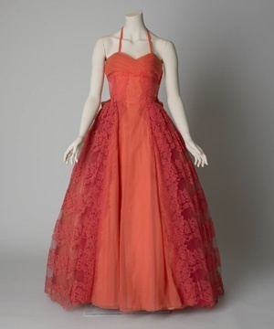
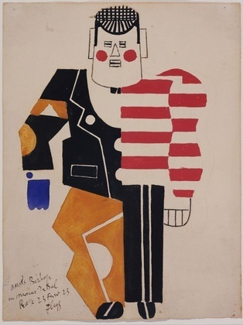
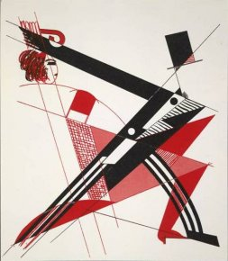
VI. Dance costume in museums and archives: collecting designs and surviving costumes, conservation, and display techniques

Slide 15
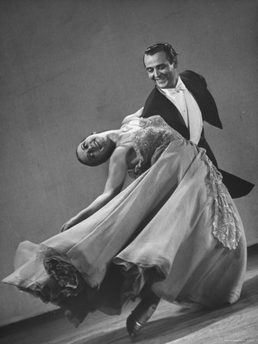
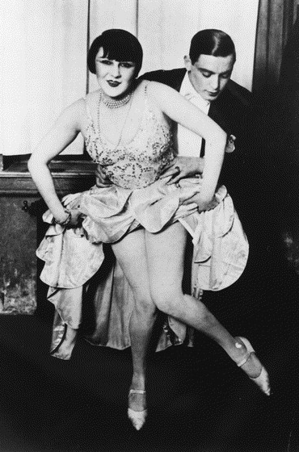
VII. Fashion and popular dance: the relationship between new styles of dance and fashionable dress, past and present

Slide 16
VIII. Dance costume and artistic expression: their reciprocal relationship

Slide 17
As was the case for the first Costume Colloquium, the second edition is being promoted by
Involved are numerous national and international institutions
the Romualdo Del Bianco Foundation
under the auspices of Life Beyond Tourism
together with the
Association Friends of the Costume Gallery

Slide 18
Special Events and Venues which are being organized for all participants include:

Slide 19
an exclusive visit to the newly opened exhibition Bronzino: Artist and Poet and a reception at the Loggia of the Palazzo Strozzi

Slide 20
an exclusive visit to the Museum Casa Martelli and a dance performance in the palace ballroom

Slide 21
a premier showing of the dance costume exhibition in the Palazzo Medici-Riccardi created exclusively for Costume Colloquium by the Australian National Institute of Dramatic Art

Slide 22
an optional Post Conference Excursion to Siena will include exclusive visits to the museums of Santa Maria della Scala, the Municipality of Siena as well as a visit and reception at a Sienese Contrada.

Slide 23
Costume Colloquium II: Dress for Dance
www.costume
-
textiles.com
November 4th – 7th 2010
Florence, Italy

